Slide 1
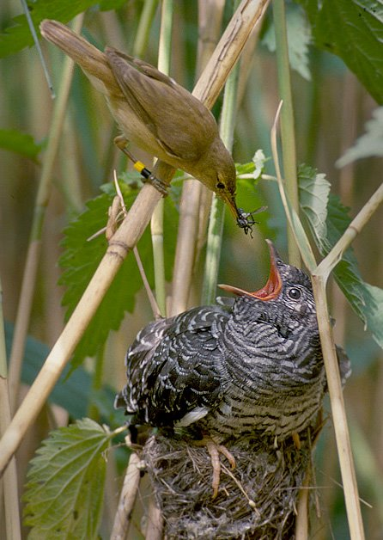

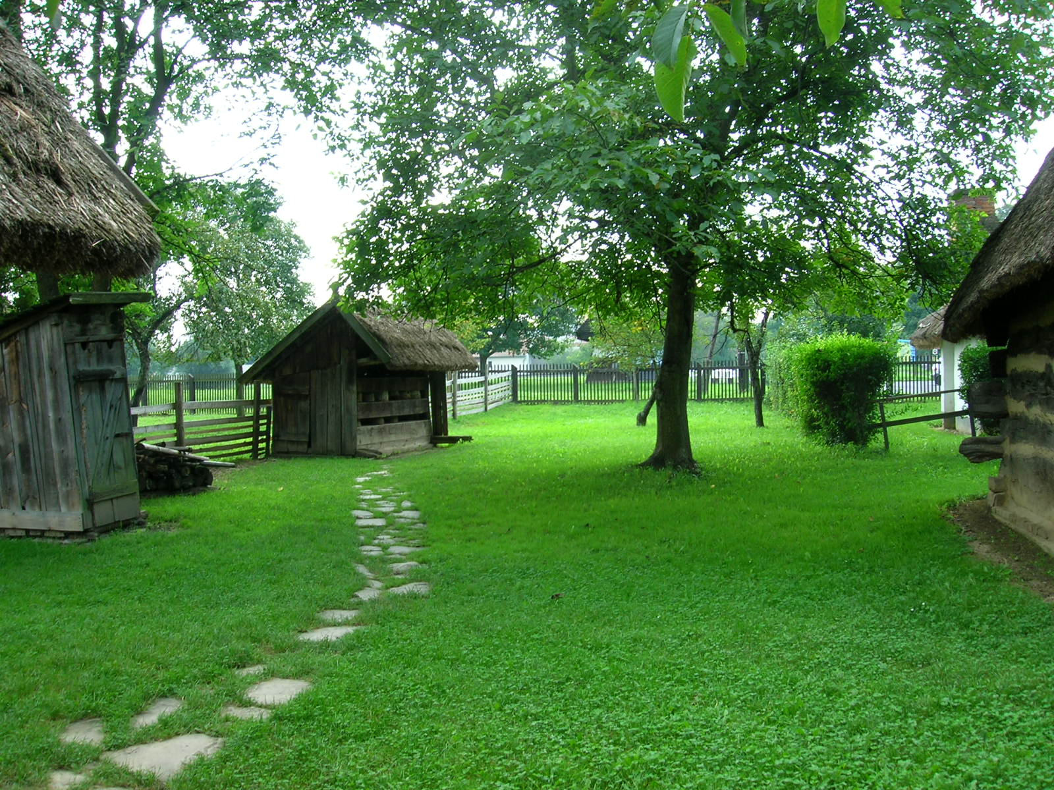
Backyard Cuckoo Hashing:
Constant Worst-Case Operations with a Succinct Representation
Yuriy Arbitman Moni Naor Gil Segev

Slide 2

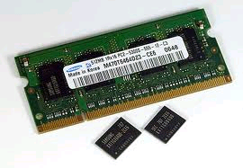
Dynamic Dictionary
Data structure representing a set of words S
From a Universe U
Operations:
Lookup
Insert
Delete
Performance:
Lookup time and update time
Memory consumption
Size of S is n
Size of universe U is u

Slide 3
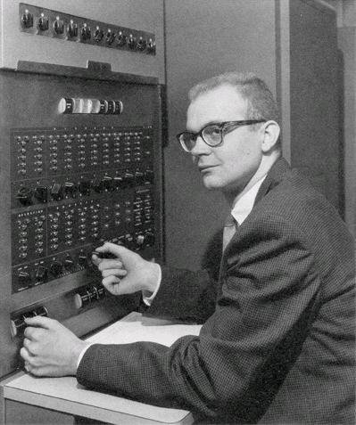
The Setting
Dynamic dictionary:
Lookups, insertions and deletions
Performance:
Lookup time and update time
Space consumption
Desiderata:
Constant-time operations
Minimal space consumption
First analysis: linear probing [Knuth 63]
Tradeoffs not fully understood

Slide 4
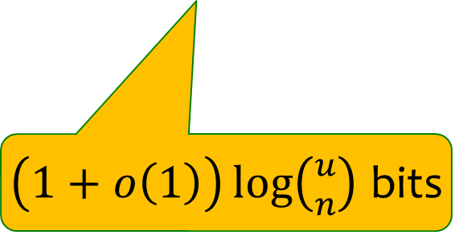
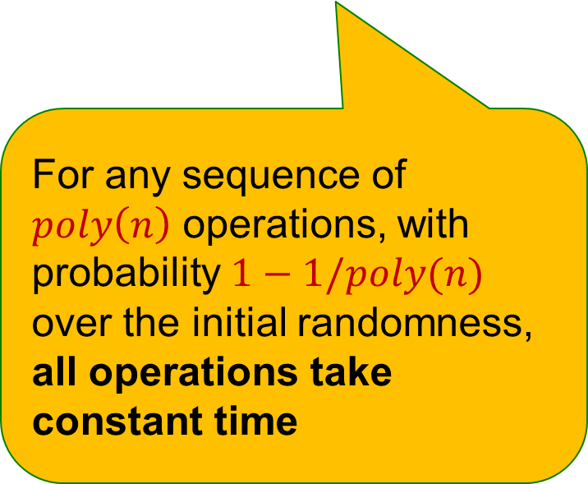
This Talk
The first dynamic dictionary simultaneously guaranteeing
Constant-time operations in the worst case w.h.p.
Succinct representation
The first dynamic dictionary simultaneously guaranteeing
Constant-time operations amortized w.h.p.
Succinct representation
For any sequence of $poly\left(n\right)$ operations, with probability $1−1/poly(n)$ over the initial randomness, all operations take constant time
$\left(1+o\left(1\right)\right)\log\left({u \atop n}\right)$ bits

Slide 5
Terminology
Information theoretic bound B
Implicit Data Structure: B + O(1)
Succinct Data Structure: B + o(B)
Compact Data Structure: O(B)

Slide 6
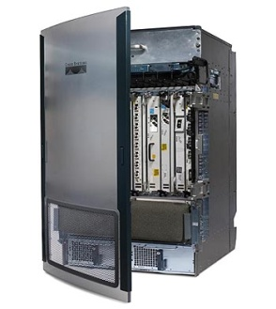
Why Worst Case Time?
Amortized guarantees Unacceptable for certain applications
Bad for hardware
E.g., routers
Withstanding Clocked Adversaries [LN93]
Showed how to reconstruct hash functions from timing information
Find bad inputs
Violate basic assumption of oblivious adversary
Elements are not ind. of the scheme’s randomness
Timing attacks in cryptography
Lipton and Naughton

Slide 7
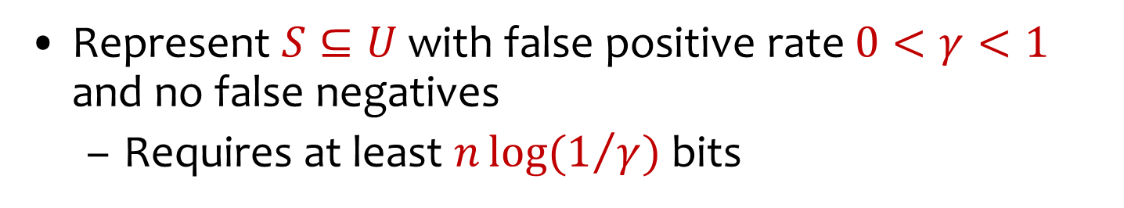
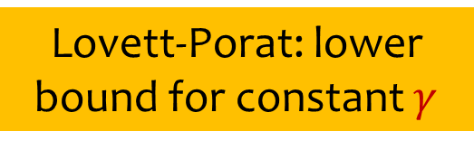

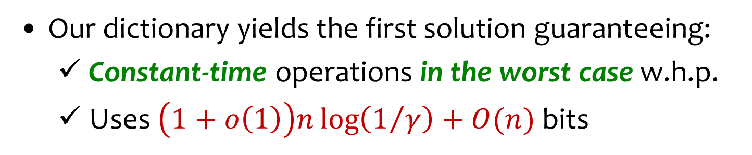
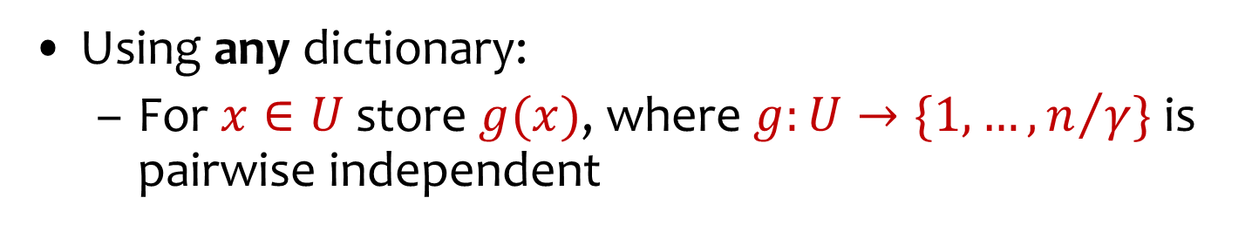
Application: Approximate Set Membership (Bloom Filter)
Represent $S⊆U$ with false positive rate $0<γ<1$ and no false negatives
Requires at least $n\log{(1/γ)}$ bits
Using any dictionary:
For $x∈U$ store $g(x)$, where $g:U→\{1,…,n/γ\}$ is pairwise independent
Lovett-Porat: lower bound for constant $γ$
Our dictionary yields the first solution guaranteeing:
Constant-time operations in the worst case w.h.p.
Uses $\left(1+o\left(1\right)\right)n\log\left(1/γ\right)+O(n)$ bits
Succinct unless $γ$ is a small constant

Slide 8
Why are most schemes wasteful?
Set of
size n
Two sources of wasted space:
Table is not full
All empty entries – wasted
A word of size log u is devoted for each element in S
Total: n log u bits
Whereas information theoretic Bound
B =log = n log u – nlog n + Θ(n)
Universe of
size u
••••••• •••••• ••••••••••• ••••••• •
If u is poly in n : to waste only
o(B) must save n log n bits
u
(
)
n

Slide 9

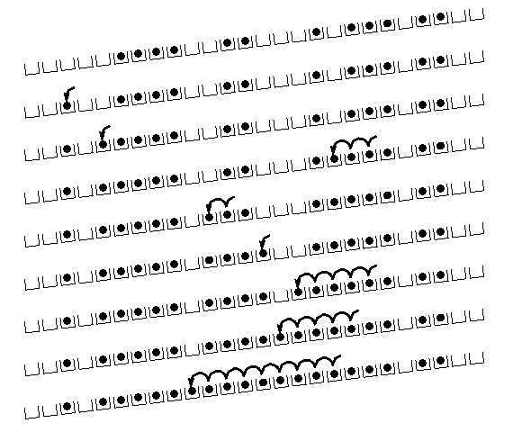
Related Work: Full Memory Utilization
Linear probing for moderate ε
Bad performance when ε close to 0
Generalizations of cuckoo hashing
[FPSS05, Pan05, DW07]
Dietzfelbinger, Weidling
Cain, Sanders, Wormald
Finer analyses in the static setting: [CSW07, DGMMPR09, DM09, FM09, FP09, FR07, LP09]
Drawbacks:
No firm upper bounds on the insertion time in the worst case
Operations times depend on ε
Filter hashing of [FPSS05]
No efficient support for deletions
Fotakis, Pagh,
Sanders, Spirakis
Panigrahy
Frieze, Melsted, Mitzenmacher
Dietzfelbinger, Goerdt,
Mitzenmacher,
Montanari, Pagh, Rink
Devroye, Malalla
Fountoulakis, Panagiotou
Frieze, Melsted
Fernholz, Ramachandran
Lehman, Panigrahy
Fotakis, Pagh,
Sanders, Spirakis

Slide 10

Related Work
Approaching information-theoretic
space bound:
[RR03]
(1+o(1))B bits
Amortized -expected
No efficient support for deletions
[DMadHPP06] - LATIN
O(B) bits
Extends [DMadH90]
Others: static setting
Raman, Rao
Demaine, Meyer auf der Heide,
Pagh, Pătraşcu
Dietzfelbinger,
Meyer auf der Heide
Brodnik Munro
Pătraşcu

Slide 11
Our Approach for Constant Time: Two-Level Scheme
Store most of the n elements in m bins
bins should be nearly full to avoid T empty entries
Some elements might overflow
Stored in the second level
Challenges
Handle the levels in worst-case constant time
Move back elements from second level to the bins upon deletions in worst-case constant time
o(n)
Otherwise second level overflows

Slide 12
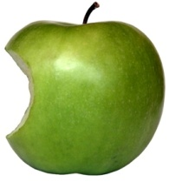
Our Approach for Optimal Space: Permutation-based Hashing
Invertible Permutations
Can use π(x) as “new” identity of x
Prefix of new name – identity of cell/bin
Know the prefix when the cell is probed
...
1
2
3
m
...
1
2
3
m

Slide 13
The Schemes
That’s so
last year
Scheme I: De-amortized cuckoo hashing
Store n elements using (2+ε)n memory words
Constant worst-case operations
Scheme II: Backyard cuckoo hashing
Store n elements using (1+ε)n memory words
Constant worst-case operations
Universe of size u
Memory word is log u bits
Independent of ε,
for any ε
~
1
>
log n
Scheme III: Permutations-based backyard cuckoo hashing
Store n elements using (1+o(1))B bits
Constant worst-case operations
u
B = log
(
)
n
B is the information-theoretic lower bound

Slide 14
Random and Almost Random Permutations
First analyze assuming true random functions and permutations available
Show how to implement with functions and permutations that:
Have succinct representation
Can be computed efficiently
sufficiently close to random
Need to adjust scheme to allow this case where only k-wise almost independent permutations are available
Step 1
Step 2

Slide 15
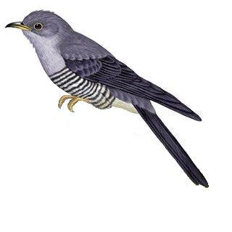

Scheme I: De-amortized Cuckoo Hashing

Slide 16
Cuckoo Hashing: Basics
Introduced by Pagh and Rodler (2001)
Extremely simple:
2 tables: T₁ and T₂
Each of size r = (1+ε)n
2 hash functions: h₁ and h₂
Lookup:
Check in T₁ and T₂
d
t
h₂(x)
c
y
x
h₁(x)
x
b
a
Where is x?
...
...
z
T₁
T₂

Slide 17
Cuckoo Hashing: Insertion Algorithm
To insert element x, call Insert(x, 1)
Insert(x, i):
1. Put x into location h_{i}(x) in T_{i}
2. If T_{i}[h_{i}(x)] was empty, return
3. If T_{i}[h_{i}(x)] contained element y, do Insert(y, 3–i)
Example:
d
t
c
y
h₂(y) = h₂(a)
x
b
h₁(e) = h₁(a)
a
e
...
...
h₁(y)
z
T₁
T₂

Slide 18
The Cuckoo Graph
Insertion algorithm achieves this
Set S ⊂ U containing n elements
h₁,h₂ : U {0,...,r-1}
Bipartite graph with |L|=|R|=r
Edge (h₁(x), h₂(x)) for every x∈S
Fact:
S is successfully stored
Every connected component in the cuckoo graph has at most one cycle
Nodes:
locations in memory
Expected insertion time: O(1)

Slide 19
Cuckoo Hashing: Properties
Many attractive properties:
Lookup and deletion in 2 accesses in the worst case
May be done in parallel
Insertion takes amortized constant time
Reasonable memory utilization
No dynamic memory allocation
Many extensions with better memory utilization
Fotakis, Pagh,
Sanders, Spirakis
Dietzfelbinger, Weidling
Panigrahy
Lehman-Panigrahy
Mitzenmacher’s survey ESA 2009

Slide 20
Deamortized Scheme
A dynamic dictionary that provably supports constant worst-case operations:
Supports any poly sequence of operations
Every operation takes O(1) in the worst case w.h.p.
Memory consumption is (2+ε)n words
Favorable experimental results
Need only polylog(n)-wise independent hash functions
Allows very efficient instantiations
via [Braverman 09]

Slide 21
Ingredients of the Deamortized Scheme
Main tables T₁ and T₂, each of size (1+ε)n
Queue for log n elements, supporting O(1) lookups
Stored separately from T₁ and T₂
The approach of de-amortizing Cuckoo Hashing with queue suggested by [Kirsh Mitzenmacher 07]

Slide 22
What do we need from the analysis?
Cuckoo graph for h₁,h₂ : U {0,...,r-1}
Edge (h₁(x), h₂(x)) for every x∈S
S is successfully stored
Every connected component in the cuckoo graph has at most one cycle
Bad event1: sum of sizes of log n connected components is larger than c log n
Bad event2: number of edges closing a second cycle in a component is larger than a threshold
Nodes:
locations in memory

Slide 23
Useful feature of the insertion procedure
During an insertion operation: when a vacant slot is reached the insertion is over
If we can remove elements that should not be in the table – can postpone the removal
Provided we can identify the removed elements
Insert(x, i):
1. Put x into location h_{i}(x) in T_{i}
2. If T_{i}[h_{i}(x)] was empty, return
3. If T_{i}[h_{i}(x)] contained element y, do Insert(y, 3–i)

Slide 24
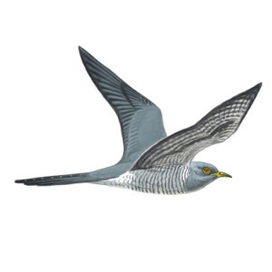
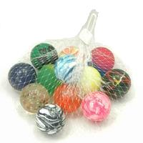
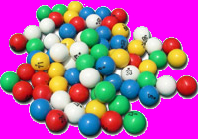
Scheme II: Backyard Cuckoo Hashing

Slide 25
This Scheme
Full memory utilization: n elements stored using (1+ε)n memory words
Constant worst-case operations
Independent of ε: for any ε =
( )
loglog n
Ω
log n

Slide 26
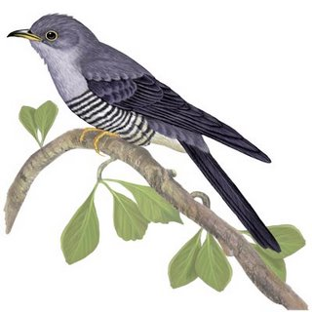
The Two-Level Construction
n
Store most of n elements in m = bins
Each bin of size d 1/ε²
Overflowing elements stored in the second level using de-amortized cuckoo hashing
When using truly random hash functions
overflow ≤ εn whp
(1+ε)
d
≈
Represent waste
Sufficient to have
n^{α}-wise independent
hash functions

Slide 27
Efficient Interplay Between Bins and Cuckoo Hashing
Can have any poly sequence
Due to deletions, should move elements from second to first level, when space is available
Without moving back, second level may contain too many elements
Key point: cuckoo hashing allows this feature!
While traversing cuckoo tables, for any encountered element, check if its first-level bin has available space
Once an element is moved back to its first level, cuckoo insertion ends!

Slide 28
Snapshot of the Scheme
T₀
Cuckoo Tables
Three Hash Functions
T₁
T₂
h₀, h₁, h₂
Queue
Bins

Slide 29
Eliminating the Dependency on ε Inside the First-Level Bins
Naive implementation: each operation takes time linear in bin size d 1/ε²
Can we do better?
First attempt: static perfect hashing inside bins
Lookup and Deletion take now O(1)
Insertion is still 1/ε² - requires rehashing
Our solution: de-amortized perfect hashing
Can be applied to any scheme with two natural properties
≈
Notes:
Israel Declaration/Proclamation of Independence

Slide 30
The Properties
For any history, at any point
Property 1: adjustment time for a new element is constant wp 1–O(1/d), and O(d) in the worst case
Property 2: need rehash wp O(1/d), rehash dominated by O(d)∙Z,
Z geometric r.v. with constant expectation
Need scheme amenable to such de-amortization:

Slide 31

The De-amortization
Key point: same scheme used in all bins
Use one queue to de-amortize over all bins
Modified insertion procedure (for any bin):
New element goes to back of queue
While L moves were not done:
Fetch from head of queue
Execute operations to adjust the perfect hash function or to rehash
Unaccommodated element after L steps?
Put in head of queue
Notes:
Consider inserting a link in this slide to slide 16 “Main Idea of De-amortization”.

Slide 32
Analysis: Intuition
Most jobs are of constant size
Small ones compensate for large ones
Thus: expect queue to shrink when performing more operations per step than the expected size of a component
By looking at chunks of log n operations, show that each chunk requires c log n work whp
Sequence of operations
N
Work( )
< c log n

Slide 33
A Specific Scheme
d elements stored in d memory words
Two-level hashing in every bin:
Pair-wise independent h: U [d²] Need 2 memory words to represent h
g: Image(h) [d] stored explicitly as a list of pairs Evaluated and updated in constant time, using a global lookup table
Introduces restrictions on d:
Description of g should fit into O(1) words
Description of lookup tables should fit into εn words
To allow O(1) computation
d <
log n
loglog n
ε >
loglog n
log n

Slide 34
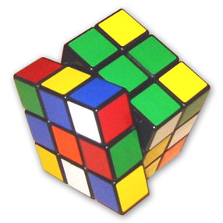
Scheme III: Permutation-based Backyard Cuckoo Hashing
+

Slide 35
Information-Theoretic Space Bound
So far: n elements stored using (1+o(1))n memory words
For universe U of size u, this is (1+o(1))n log u bits
However, information-theoretically, need only B ≈ n log(u/n) bits!
A significant gap for a poly-size universe
Set of
size n
u
B = log
Universe of
size u
(
)
n

Slide 36
Random and Almost Random Permutations
First analyze assuming true random permutations available
Show how to adjust to case where only k-wise almost independent permutations are available
Step 1
Step 2
Invertible Permutations
Can use π(x) as “new” identity of x

Slide 37
IT Space Bound – General Idea
Utilize bins indices for storage:
Randomly permute the universe
Use bin index as the prefix of elements in the bin
...
1
2
3
m
...
1
2
3
m

Slide 38
First-Level Hashing via Chopped Permutations
Take random permutation π: U U
Denote π(x)= π_{L}(x)|| π_{R}(x)
π_{L}(x) is of length log m bits Encodes the bin
π_{R}(x) is of length log(u/m) bits Encodes the new identity of element
m ≈ n/d number of bins
...
...
π(x)= = 0 0 0 1 1 1 0 0 1 1 0 1
π_{L}(x)
π_{R}(x)
Saving:
n log n/d bits
...
1
2
3
m
Instance of Quotient functions [DMadHPP06]

Slide 39
Secondary table: permutation based cuckoo hashing
Secondary table may store L=εn elements
Can we devote log u bits for each element?
Case u > n^{1+α}: then log u ≤ (1/α + 1) log(u/n)
can allow storing elements using log u bits .
For general case: too wasteful
Use a variant of the de-amortized cuckoo hashing scheme that is based on permutations,
each element is stored using roughly log(u/n) bits instead of log u bits
No need
to change

Slide 40
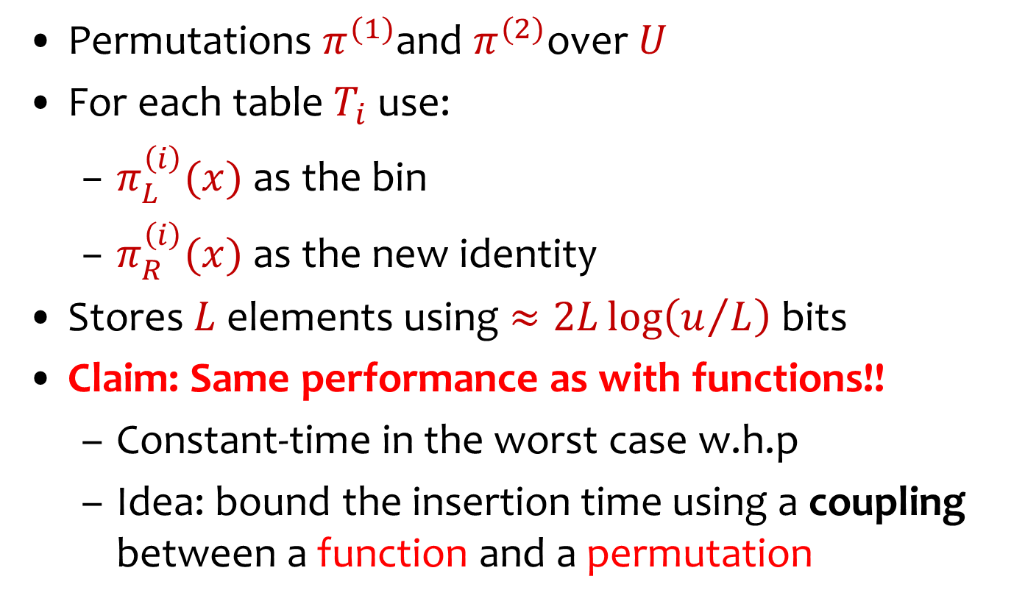
Permutation-based Cuckoo Hashing
Permutations $π^{(1)}$and $π^{(2)}$over $U$
For each table $T_{i}$ use:
$π_{L}^{\left(i\right)}(x)$ as the bin
$π_{R}^{\left(i\right)}(x)$ as the new identity
Stores $L$ elements using $≈2L\log\left(u/L\right)$ bits
Claim: Same performance as with functions!!
Constant-time in the worst case w.h.p
Idea: bound the insertion time using a coupling between a function and a permutation

Slide 41

Cuckoo Hashing with Chopped Permutations
Replace random functions with random permutations
Need to store L=εn elements in cuckoo tables
De-amortized cuckoo hashing relied on:
Event 1: Sum of sizes of log L components is O(log L) whp
Event 2: W.p. O(r ^{–(s+1)}) at most s edges close second cycle
Monotone!
Build: An n-wise independent permutation from a random function by “embedding”
Looking in at most (1+ε)n locations
Need at least n new locations
Lemma: For L =εn, r=(1+δ) L, the cuckoo graph on [r]x[r] with L edges defined by random permutations is a subgraph of the cuckoo graph on [r]x[r] with L(1+ ε) edges defined by corresponding random functions

Slide 42
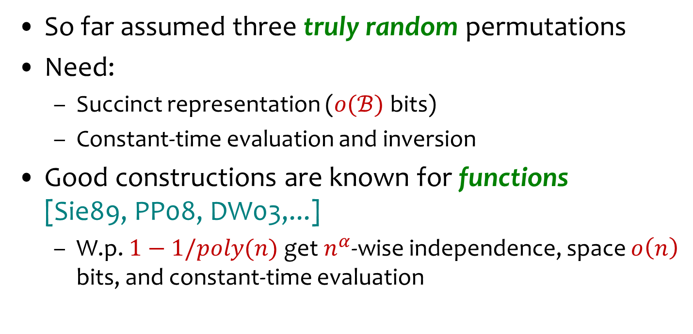
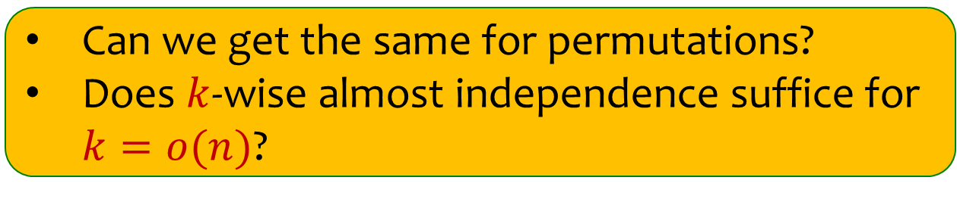
Using Explicit Permutations
So far assumed three truly random permutations
Need:
Succinct representation ($o(ℬ)$ bits)
Constant-time evaluation and inversion
Good constructions are known for functions [Sie89, PP08, DW03,...]
W.p. $1−1/poly(n)$ get $n^{α}$-wise independence, space $o\left(n\right)$ bits, and constant-time evaluation
Use limited independence?
Siegel
Pagh &
Pagh
Dietzfelbinger &
Woelfel
Can we get the same for permutations?
Does $k$-wise almost independence suffice for $k=o(n)$?

Slide 43
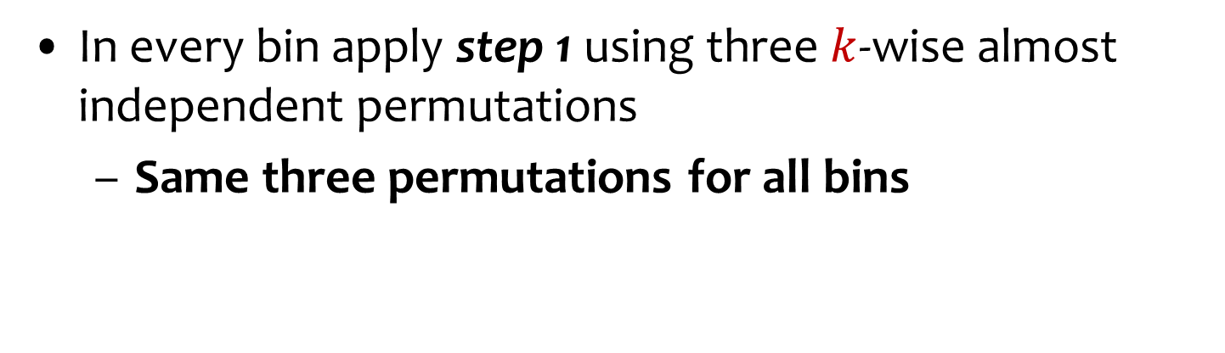
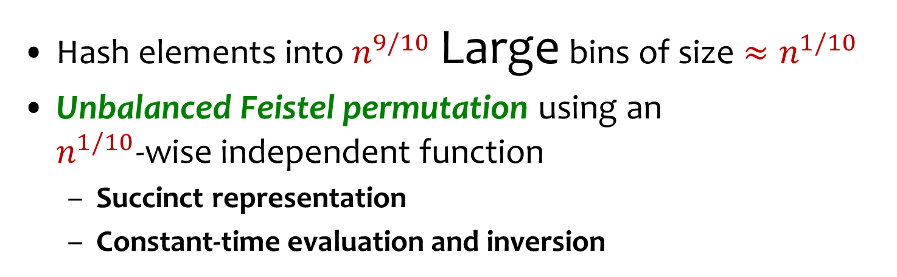
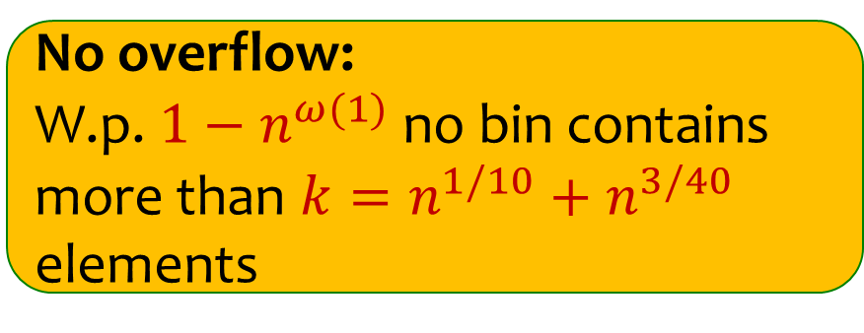



Dealing with Limited Independence
Hash elements into $n^{9/10}$ Large bins of size $≈n^{1/10}$
Unbalanced Feistel permutation using an $n^{1/10}$-wise independent function
Succinct representation
Constant-time evaluation and inversion
$$L$$
$$R$$
$$f$$
No overflow: W.p. $1−n^{ω(1)}$ no bin contains more than $k=n^{1/10}+n^{3/40}$ elements
Bin #
new id
In every bin apply step 1 using three $k$-wise almost independent permutations
Same three permutations for all bins
h₀, h₁, h₂

Slide 44
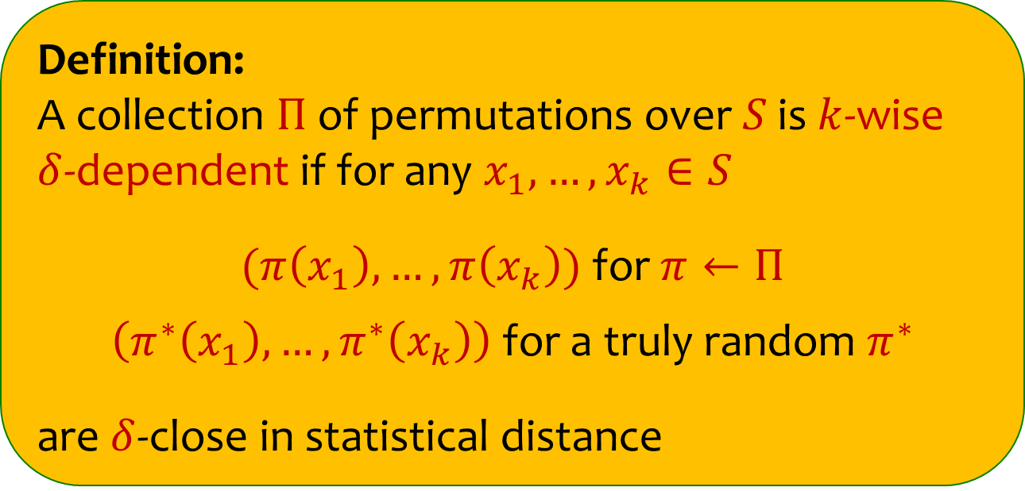
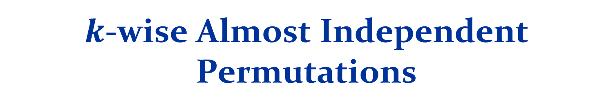
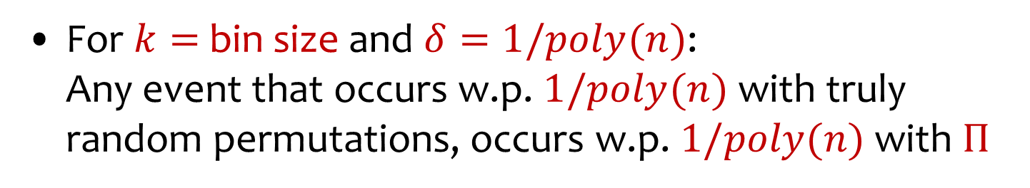
$k$-wise Almost Independent Permutations
Definition: A collection $Π$ of permutations over $S$ is $k$-wise $δ$-dependent if for any $x_{1},…,x_{k}∈S$
$(π\left(x_{1}\right),…,π\left(x_{k}\right))$ for $π←Π$
$\left(π^{∗}\left(x_{1}\right),…,π^{∗}\left(x_{k}\right)\right)$ for a truly random $π^{∗}$
are $δ$-close in statistical distance
For $k=$bin size and $δ=1/poly(n)$: Any event that occurs w.p. $1/poly(n)$ with truly random permutations, occurs w.p. $1/poly(n)$ with $Π$

Slide 45
Properties of Hash constructions
Siegel’s construction:
With probability at least 1/n^{c}, the collection F is n^{α}-wise independent for some constant
0 < α < 1 that depends on |U| and n.
In general PP and DW
Much simpler
give weaker assurance
Dietzfelbinger and Rink (2009)
Can use DW and get similar property

Slide 46
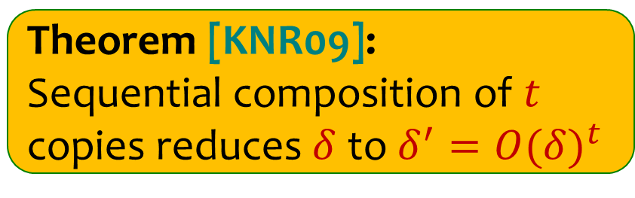

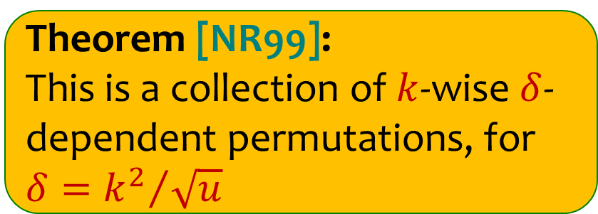
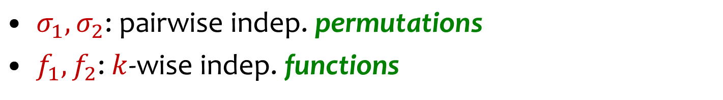



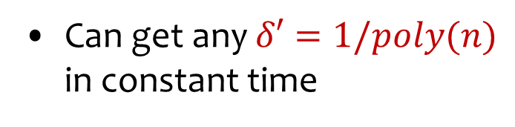
An Explicit Construction
INPUT
$σ_{1},σ_{2}\text{: }\text{pairwise} \text{ind}\text{ep}\text{. }\text{permutations}$
$f_{1},f_{2}$: $k$-wise indep. functions
$$σ_{1}$$
Theorem [NR99]: This is a collection of $k$-wise $δ$-dependent permutations, for $δ={k^{2}}/{\sqrt{u}}$
$$f_{1}$$
$$f_{2}$$
Theorem [KNR09]: Sequential composition of $t$ copies reduces $δ$ to ${δ^{′}=O(δ)}^{t}$
Can get any $δ′=1/poly(n)$ in constant time
$$σ_{2}$$
OUTPUT

Slide 47

Putting it together
Partition into LARGE bins using chopped Feistel permutation
Apply Backyard solution with chopped k-wise independent permutations
Same randomness used in all bins

Slide 48
Future Work
Limitation of error:
approx of k-wise randomness
Impossibility of deterministic?
Clocked adversaries
Come up with provable solution without stalling
Optimality of our constructions: Is the 1–1/poly(n) probability necessary?
Find the optimal ε
Does applying “two-choice” at first level help?
Changing dictionary size n
General theory of using Braverman like results
Find k-wise almost ind. permutations where
Constant time evaluation
K > u^{1/2}

